Slide 1
Telling the statistics behind the stories and the stories behind the statistics ISI Side Event at the 51st Session of the UN Statistical Commission: Effective Communication of Statistics: Monday, 2 March, 13:15 – 14:30 pm,
A. John Bailer
baileraj@MiamiOH.edu
@john_bailer
@statsandstories

Slide 2
Outline
0. Why are you here? Communication challenges? Audience?
1. What should your audience be asking you?
2. What statistical concepts do you want to communicate?
3. APPENDICES:
Concepts to consider
BONUS material Case study: Podcasting with journalists

Slide 3
Summary (TL; DL <-- presentation analog to TL; DR)
S1: ISI is great professional community and you should join!
S2: Know your audience and tailor your message to them
S3: Don’t fall in love with point estimates – no change may be the story
S4: There are other measures of center that might be more interesting than the center (mean)
S5: Working with journalists will teach you to target your message

Slide 4
Why are you here?*
want to know about the discussion matter of the event
relates to my current work on revising the Handbook for Statistical Organization
achieve the better experience and to gathering the latest knowledge.
To participate / ISI member
It is important for us … to learn about Effective Communication of Statistics.
* Voluntary response sample to Google form (n=8) – no claims of generalizability [hey, I’m a statistician :-) and I need to identify limitations of my studies]

Slide 5
Communication challenges?
Lack of produce proper data and provide it to the user / Research and developments
Advising on best practices on communication for a global audience
users trust in data / Very important event
I am able to face all kinds of situation. I am trying to make myself as a successful career in Statistics.
Evidence based statistics for problem solution
We produce economic indicator of Farmer's Terms of Trade Statistics but it is difficult to understand by public.

Slide 6
Target Audience for your work
Government (n=3)
NSOs
Experts
Data users are my Target audience at first stage in public sector
Others? Public mentioned on previous slide

Slide 7
What should your audience be asking you?
Who is your audience?
Is your audience statistically literate?
Statistical literacy is portrayed as the ability to interpret, critically evaluate, and communicate about statistical information and messages. (Gal 2002 ISR)
"statistical literacy" refers broadly to two interrelated components, primarily
(a) people's ability to interpret and critically evaluate statistical information, data-related arguments, or stochastic phenomena, which they may encounter in diverse contexts, and when relevant
(b) their ability to discuss or communicate their reactions to such statistical information, such as their understanding of the meaning of the information, their opinions about the implications of this information, or their concerns regarding the acceptability of given conclusions.
Do we have a responsibility to help develop the statistical literacy skills of our audience?

Slide 8
What can we learn from journalists?
“The job of the journalist is to make the significant interesting.” - Bill Kovach and Tom Rosenstiel’s The Elements of Journalism.
Nick Kristoff: Reporters should not lead their reports with a lot of numbers and data but rather tell a story that grabs the reader and illustrates the big data to come later in the story. (R. Campbell)
Journalists are supposed to put facts into context [and this] is the foundation of my work as a reporter and my work in the classroom as I teach journalism students how to write news. (R. Pennington)
What is the job of the statistician?

Slide 9
1. Statistician’s job? { = Job of National Statistical Offices? }
To conduct and to communicate the results of analyses to have impact.
“Grabbing the reader [audience]”
making the “significant interesting”
“putting facts in context”
all important for producing effective and impactful analyses
How often do we think about this?

Slide 10
Working with Journalists – News & Numbers
My early conversion to thinking about journalism and statistics – Cohn and Cope News & Numbers – classic book for journalists.
Included questions journalists should ask about research AND statisticians should be ready to answer!
Questions inspired by News & Numbers -

Slide 11
1. Working with Journalists – journalistic challenge?
Example Questions (from Chapter - Testing the Evidence):
How do you know?
Have claims been subjected to any studies or experiments?
If studies have been done, were they acceptable ones, by general agreement?
Results fairly consistent with those from related studies, and with general knowledge in the field? { JB: change in context of time series }
Finding context? Consensus with other experts in the field?
Conclusions backed by believable statistical evidence? Degree of certainty or uncertainty?
Reasonable theoretical plausibility to the findings?

Slide 12
1. Other perspectives: Tim Harford- Financial Times index card
https://medium.com/financial-times/tim-harfords-guide-to-statistics-in-a-misleading-age-652a597c1d88
1. Observe your feelings - gut reaction
2. Understand the claim
What does it mean?
Causal?
What’s being left out
3. Get the backstory
4. Put things in perspective
Is that a big number
What is the historical trend?
Beware ‘statistical significance’
5. Embrace imprecision
6. Be curious
Go another click
Treat surprises as a mystery

Slide 13
1. Other perspectives: David Spiegelhalter The Art of Statistics
10 Rules of Effective Statistical Practice
Statistical methods should enable data to answer scientific questions
Signals always come with noise
Plan ahead, really ahead
Worry about data quality – everything rests on the data
Statistical analysis is more than a set of computations
Keep it simple – main communication should be as basic as possible
Provide of assessments of variability – with the warning that margins of error are generally bigger than claimed
Check your assumptions
When possible, replicate!
Make your analysis reproducible

Slide 14
1. Other perspectives: David Spiegelhalter The Art of Statistics
10 Questions to ask when confronted by a claim based on statistical evidence – trustworthiness of numbers (1-3), source (4-6), interpretation (7-10)
How rigorously has the study been done?
What is the statistical uncertainty / confidence in the findings?
Is the summary appropriate
Reliability of the source?
Is the story being spun?
What am I not being told?
How does the claim fit with what else is known?
What’s the claimed explanation for whatever has been seen?
How relevant is the story to the audience?
Is the claimed effect important?

Slide 15
1. My personal working list
What is claimed? and is it appropriate?
Who is claiming this?
Why is it claimed?
Is this a good measure of impact?
How is the claim supported?
What evidence is reported?
What is the quality / strength of the evidence?
Is the claim reasonable in itself?
Does prior belief impact my belief? Confirmation bias?
How does this claim fit with what is already known?
How much does this matter for me?
Comparison of population perspective vs. individual perspective?
Will I change my behavior as a consequence of this?

Slide 16
EXAMPLE: World's population could swell to 10.9 billion by 2100, U.N. report finds
(NBC News - https://www.nbcnews.com/mach/science/world-s-population-could-swell-10-9-billion-2100-u-ncna1017791)
What is claimed? and is it appropriate?
World population of 10.9B by 2100
Who is claiming this?
UN Dept of Economic and Social Affairs – World Population Predictions
Based on “The population estimates and projections contained in this revision cover a 150-year time horizon, which can be subdivided into estimates (1950-2020) and projections (2020-2100).”

Slide 17
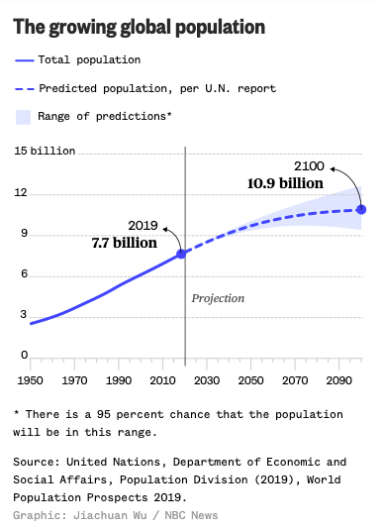
EXAMPLE: World's population could swell to 10.9 billion by 2100, U.N. report finds
Why is it claimed?
Analysis and modeling of population counts, fertility, mortality, migration, included in models

Slide 18
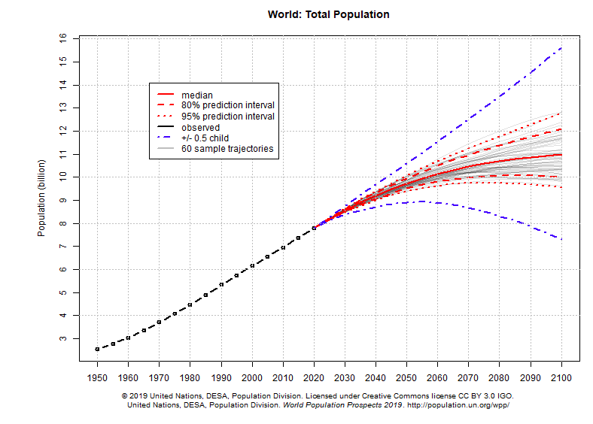
EXAMPLE: From Population Division World Population Prospects 2019 https://population.un.org/wpp/Graphs/Probabilistic/POP/TOT/900
Explanation: These charts show estimates and probabilistic projections of the total population for countries or areas, geographical aggregates and World Bank income groups as defined in Definition of Regions. The population projections are based on the probabilistic projections of total fertility and life expectancy at birth. These probabilistic projections of total fertility and life expectancy at birth were carried out with a Bayesian Hierarchical Model. The figures display the probabilistic median, and the 80 and 95 per cent prediction intervals of the probabilistic population projections, as well as the (deterministic) high and low variant (+/- 0.5 child).

Slide 19
EXAMPLE: World's population could swell to 10.9 billion by 2100, U.N. report finds
Is this a good measure of impact?
Hard to argue with this outcome
How is the claim supported?
What evidence is reported?
What is the quality / strength of the evidence?
Estimates and projections - Model predictions – extrapolations with models calibrated to fit of many different data sources.
26th round of global population projections since 1951 { from UN report }

Slide 20
EXAMPLE: World's population could swell to 10.9 billion by 2100, U.N. report finds
Is the claim reasonable in itself?
How does this claim fit with what is already known?
Does prior belief impact my belief? Confirmation bias?
How much does this matter for me?
Comparison of population perspective vs. individual perspective?
Will I change my behavior as a consequence of this?
”many of the fastest-growing regions are among the poorest, which could exacerbate issues of hunger and displacement…Scientists are also concerned about the effect of population growth on climate change. ”
(from NBC report)

Slide 21
2. What statistical concepts to you want to communicate?
1. What did you measure and how did you measure it?
Inputs to models: trends in fertility, mortality, migration
Output: estimates (1950-2020) and projections (2020-2100).
2. How did you generate the the data?
Bayesian Hierarchical model with median and prediction intervals
3. How did you summarize the data?
Line graph with range of predictions that increases as the guesses are more distant into the future
4.What conclusions do you draw from the data?
Confident that population will grow in the future

Slide 22
2. Communicating with caution?
World Population projection easy story to tell.
Harder stories? Caution when reporting …
Point estimate of % change when margin of error around change consistent with NO change observed
Change from month to month without reporting longer term patterns
Mean change reporting when real story might be found in the percentiles (e.g. could the trend in the 5th percentile of the income distribution be completely different than the average?)

Slide 23
Summary
S1: ISI is great professional community and you should join!
S2: Know your audience and tailor your message to them
S3: Don’t fall in love with point estimates – no change may be the story
S4: There are other measures of center that might be more interesting than the center (mean)
S5: Working with journalists will teach you to target your message

Slide 24
Thank you!
Thank you for your attention and interest!
John Bailer, ISI President
Web page: http://www.users.miamioh.edu/baileraj
Email:
baileraj@miamioh.edu
Twitter:
@john_bailer
@statsandstories

Slide 25
APPENDICES: Concepts to consider
3.1 Causality
Suggested in ...
… headline
… story
… original source (what does your press release suggest?)
… Reverse causality possible?

Slide 26
3. Concepts (continued)
3.2 Variables
… what are you measuring? Measuring society involves assumptions (see C. Nagaraja)
… Measurement levels
… Validity / Reliability

Slide 27
3. Concepts (continued)
3.3 Uncertainty / Variability
… Uncertainty := property of humans [epistemic]
… Variability := trait of system [aleatory]

Slide 28
3. Concepts (continued)
3.4 Data Generation / Producing Data
(Tip of the hat to Moore and McCabe)
… Samples (probability vs. convenience)
… Experiments
… Observational
* cross-sectional / case-control / longitudinal

Slide 29
3. Concepts (continued)
3.5 Describing Data
… Distribution
* location / spread / shape (skewness, modality)
… Relationships
* numeric variables / categorical variables
… Risk Measures (baseline, OR, RR, RD)

Slide 30
3. Concepts (continued)
3.6 Drawing Conclusions from data
… Estimates * point / interval
… Hypothesis Tests * P-values / Signif Testing
… Modeling

Slide 31
4. S+S: History and Context
CAS Quantitative Literacy (QL) considerations – QL FLC
Challenge to demonstrate infusing QL in Humanities course
Team teach “News & Numbers” Honors course with Richard Campbell (2009)
Serving on ASA Board of Directors (2011-13), ISI Council (2009-13), ISI EC PLUS
First World Statistics Day (20 Oct 2010)

Slide 32
S+S: History and Context (continued)
Desire: help broader community understanding the statistical aspects of complicated stories
Intended audience? Journalists, statisticians, general public, students, teachers (of introductory statistics and more!)
Inspirations? Freakonomics (economist + writer), Science Friday, NPR Car talk {Aspirational goal: syndication? }
Model? Nightline (3-5 minute introduction followed by conversation)

Slide 33
S+S: Early Decisions
From Start to First Episode:
Production and recording logistics (radio studio); theme music (stock20.com – play intro!/may change soon); web site (purchased domains - statsandstories.net; *.biz; *.org)
Who is “on air”? Moderator + 2 panelists (stat, journalist) + guest
Topics for Episodes? Mix of serious and fun. Timely topics good.
Post-production – mp3, web site, iTunes, promotion (Twitter, Email)

Slide 34
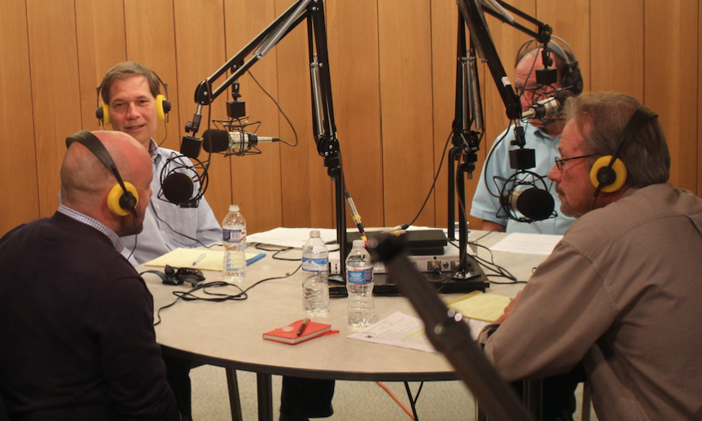
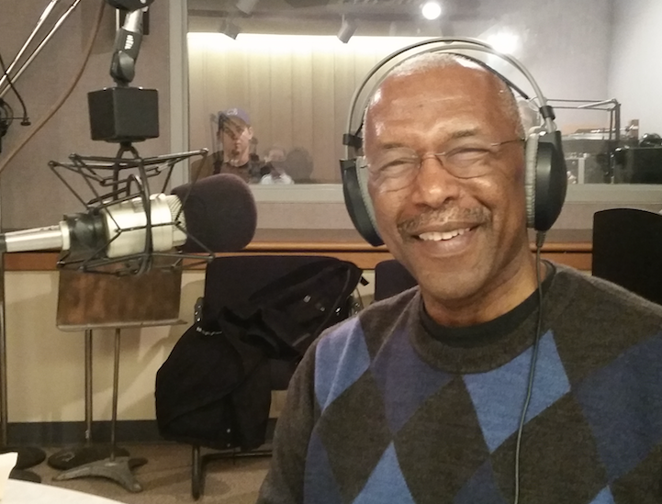
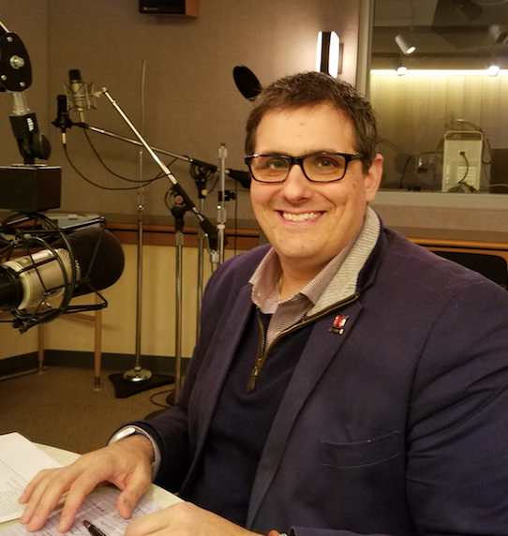
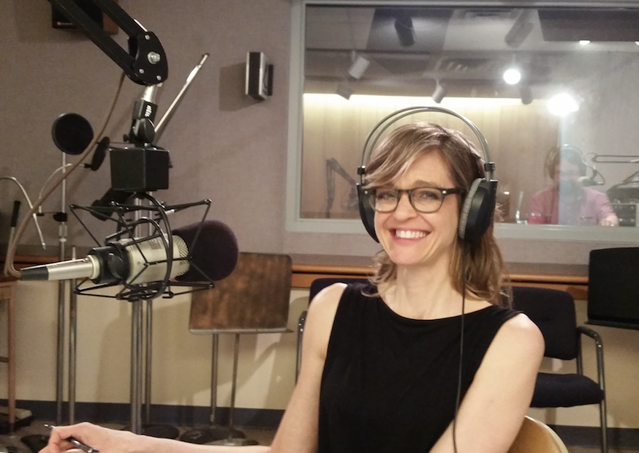
S+S: Early Decisions– live guests in studio …

Slide 35
S+S: Early decisions – early review and need to change
Feb 2013 - First guest Tommy Wright (Census) invited + show recorded. Used scripted program notes.
March 2013 – Sent out program for comments …
[+] nice idea / Bob’s voice / person-on-the-street
[-] too long to get to interview / tech jargon /
comments-responses <1.5min [‘ear fatigue’]
Suggestions:
Point person to coordinate flow of conversation & challenge jargon
Lots of editing of current program + modifications for next recording
Mar 2013 – Jim Albert recording

Slide 36
S+S: Early decisions – post-recording issues
Transcripts before release (accessibility) – student workers at first (now pay for transcription).
Post episode to web page and Apple Podcasts. (Please rate us on Apple Podcasts!)
Send out tweet (from Twitter handle @statsandstories – feel free to follow! Retweets and favorites help)
Broadcast email to interested colleagues (ASA, ISI, others)
Can’t track iTunes subscriptions but Google Analytics on www.statsandstories.net

Slide 37
S+S Checklist for Episode
IDENTIFYING and PREPARING for guest
Request biosketch from guest + consider title options + questions for person on the street
BEFORE guest arrives { modify for virtual guests }
travel and lodging arrangements for guest
PACKAGE production*
PERSON ON THE STREET production*
DURING guest visit and recording
Release form signature to guest
Quick intro to recording studio (e.g. position of mics, water caps)
AFTER RECORDING but before release
Combine package + person-on-street segments + guest conversation
Transcript

Slide 38
S+S Checklist for Episode (continued)
RELEASE
Email contacts at Miami, ASA and beyond with announcement
Twitter (S+S): tweet episode release
Facebook (S+S, other): announce episode release
Social media from CAS?
Social media from University?

Slide 39
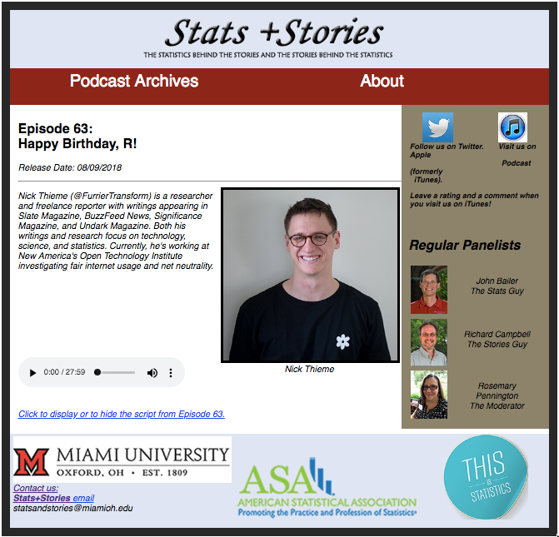
Going live! (2013-middle of 2018)

Slide 40
S+S: Evolution– to present form
Partnership with American Statistical Association (ASA) – President Barry Nussbaum
Benefits:
Budget for transcriptions + Hiring part-time producer!
Connection with speakers introduced by a professional society
Promotion of program by ASA (ISI also promotes!)
Connection to ASA-RSS Significance editor – joint promotion of authors/guests
Challenge:
more frequent and regular release of episodes: move from every 6 weeks to 2 weeks!
Lessons from the professionals? Science Friday visit – regular release and website

Slide 41
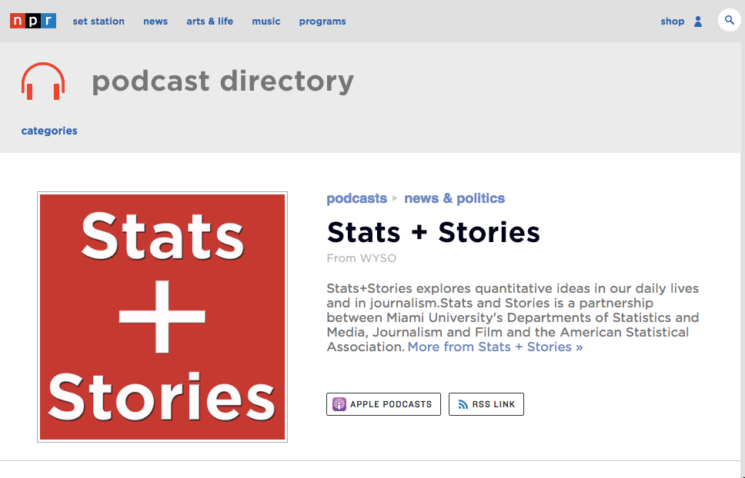
Connected to public radio in the US (WYSO)

Slide 42
3. Evolution– to present form
Visit www.statsandstories.net and you will see:
A carousel of our latest episodes (images: pexels.com)
A list of topics that we cover
A back catalog of all of our previous episodes
Connection to our Soundcloud and Twitter

Slide 43
3. Evolution– mini rebrand
We are able to more modernize our output
Changed our logo
Moved the backlog to SoundCloud
Using our Twitter account in a more engaging way

Slide 44
S+S: Evolution– topics covered?
Broad range of topics and guests …
Significance featured authors – 53 (P. Guttorp), 63 (N. Thieme), 59 (L. Bornn), 60/66 (A. Georgiou), 91 (A. Carriquiry)
Sports – 1, 18, 21, ... 59, 80
Health - 3, 5, 8, 9, 15, 26, 27
Politics – 29, 51, 66, ..., 90, 92
Journalists – 12, 16, 17, 18, 19, 29, ... 61, 71, 81
Statisticians – 1, 2, 4, 8, 9, 11, 13, 15, 19, 20, 21, 26, 27, 31, 32, 35, 36, 37, 44, 45, 46, 48,52, 53, 54, 59, 62, 65, 66, 68
Miami Guests – 3, 6, 22, 23, 24, 25

Slide 45
S+S: Evolution– changes from start
New moderator (Bob Long retired) - Welcome Rosemary Pennington (public radio and podcast experience!)
Partnership with ASA (part of ASA presidential initiatives)
Funding to support transcription
Increased frequency of program release
(S+SS introduced)
Promotion (Twitter+)

Slide 46
S+S: Evolution– frequency of episodes
With more funding and growth we were able to up the amount of episodes and increase both audience participation as well as book more high profile guests

Slide 47
S+S: Evolution– current state
All guests virtual (audio quality still good – interaction tougher)
Target: One episode per week
External transcription services and hiring a part-time producer

Slide 48
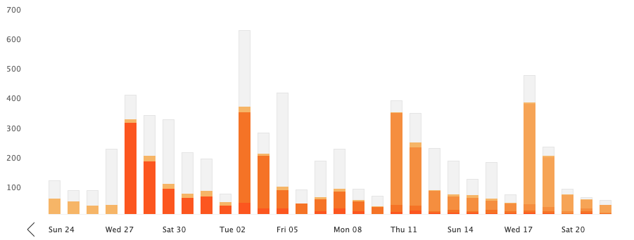
S+S: Evolution– is anyone listening?
Since our mini rebrand, we switched to hosting to the podcast on Soundcloud which gives us more data on who is listening
ASA partnership led to ASA promotion earlier last year, these are our numbers from the past month (orange bars are the most listened to single episode on that day, grey bars are our back catalog on those days)

Slide 49
3. Evolution– is anyone listening?
Which Episodes Are Doing Well? (count of >2 minutes listening)
For the past month (top row: #89, #90, #91; bottom row: #65, #66, #70)
All time

Slide 50
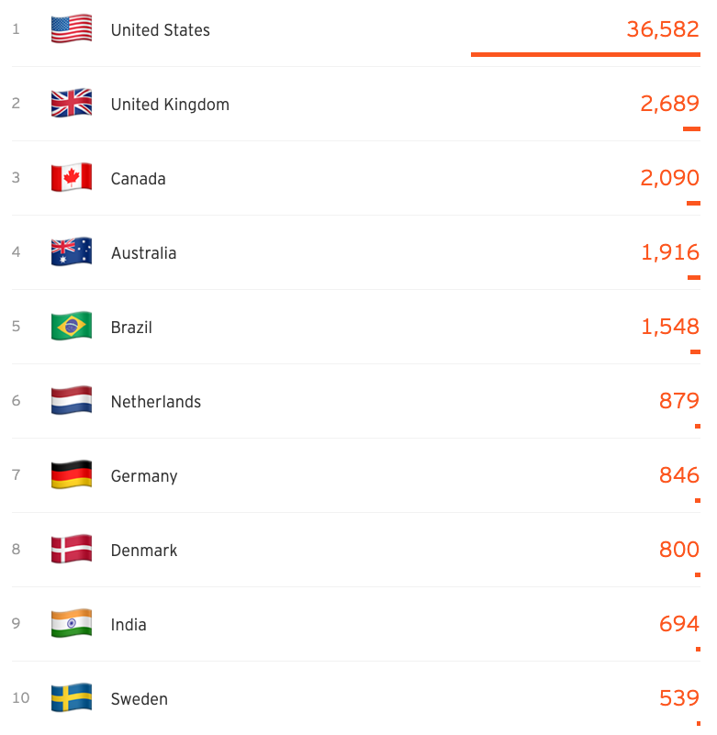
S+S: Evolution– is anyone listening?
Listened to in 148 countries (from Soundcloud – since episode #64).
Here’s a quick look at the top ten countries that are listening to Stats and Stories

Slide 51
S+S: Future
Goal remains … Promoting good reporting and good statistical thinking
Dreaming big … S+S (1,180 followers, <$25K/year budget) ... SciFri (768K followers, $20M budget)
ISI partnerships in the future? New Special Interest Group? SIG on Communicating Statistics and Data Science?

Slide 52
S+S: Future
Context:
Climate where opinion viewed as fact ... Echo chamber of news sourcing ... Addressing assertions of Fake news
S+S Short term:
Revenue to support Full-time producer – corporate sponsors?
Identify other partners
Next listener competition?
S+S Long term
Expanding the reach of S+S – syndication with NPR
Partnering with other efforts – Knight proposal Report for America

Slide 53
Contact information / Questions?
Contact information:
John Bailer
Email: baileraj@miamioh.edu
URL: http://www.users.miamioh.edu/baileraj
@john_bailer
@statsandstories

Slide 54
References
https://www.stat.auckland.ac.nz/~iase/publications/isr/02.Gal.pdf
Spiegelhalter D (2019) The Art of Statistics.
Best J () Stat Spotting: A Field Guide to Dubious Data
Cohn V et al () News and Numbers

