Slide 1
Content audits of Introductory Statistics classes in response to the ASA P-value statement
A. John Bailer
baileraj@MiamiOH.edu

Slide 2
Acknowledgements
STA colleagues:
Lynette Hudiburgh, Lisa Werwinski (who coordinate and teach many sections of our introductory statistics classes)
Karsten Maurer (who provided feedback on slides)
Participants in a multi-department focus group that discussed issues in intro statistics classes:
Tom Crist (BIO Chair)
Rose Marie Ward (KNH, Grad School Assoc. Dean)
Hank Stevens (BIO, EEEB)
Jonathan Levy (IES Director, GLG)
Joe Johnson (PSY Chair)

Slide 3
Outline
Survey of intro stat course animal kingdom - classes impacted by this effort?
What have we done so far?
Conducting a content audit
Conversations with client departments?
Challenges that remain
Recommendations

Slide 4
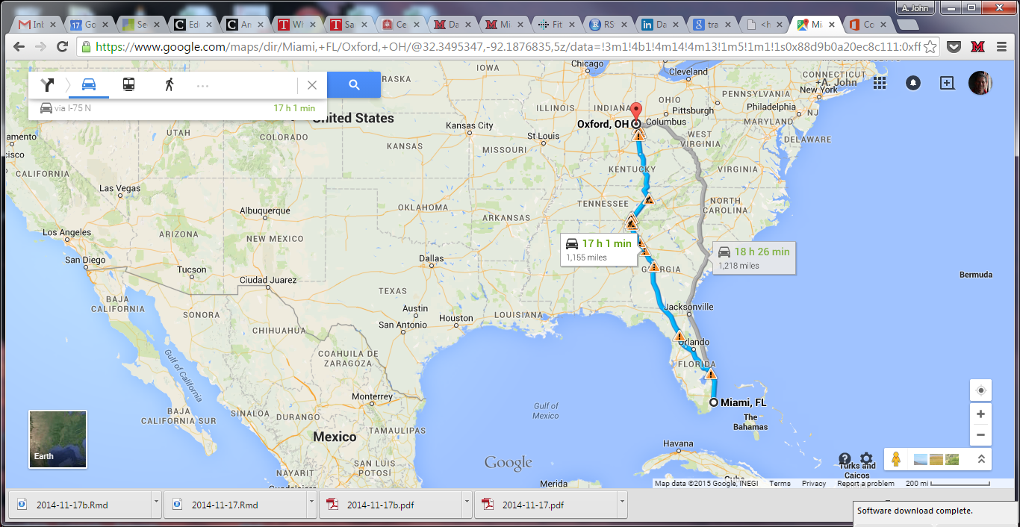
Miami University? Oxford, Ohio?

Slide 5
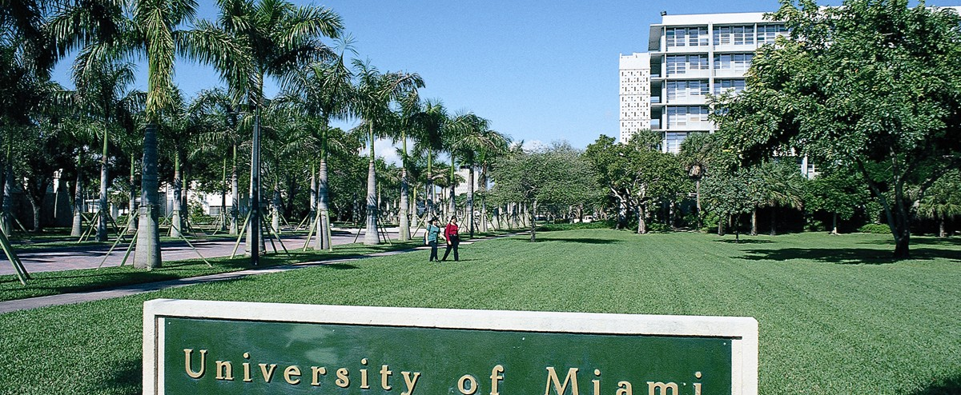
University of Miami
http://www.contacttopuniversities.com/blog/mainmenu/University%20Articles/top-universities-for-physical-therapy/umEntrance.jpg

Slide 6

Miami University

Slide 7

Miami University

Slide 8
Undergraduate introductory classes
STA 125. Introduction to Business Statistics. (3) [450 students / semester]
This course provides an introduction to data, probability, sampling and its importance to analytical decision-making in business. Upon successful completion of this course, students will have the foundational skills necessary to summarize data, describe relationships among variables, and conduct one-sample and two-sample statistical inference.
Prerequisites: MTH 102 or MTH 104 or MTH 121 or three years of college preparatory mathematics or permission of department chair.
[All entering business majors unless AP credit]
STA 261. Statistics. (4) (MPF, MPT) [600 students / semester – algebra-based stat intro]
Service course. Descriptive statistics, basic probability, random variables, binomial and normal probability distributions, tests of hypotheses, regression and correlation, analysis of variance. Emphasis on applications. Note: Credit for graduation will not be given for more than one of ISA 205, STA 261, STA 301, or STA 368. V. CAS-E.
[many majors including PSY, COM, KNH unless AP credit – Miami Plan + thematic sequence]
STA 301. Applied Statistics. (3) (MPT) [350 students / semester]
A first course in applied statistics including an introduction to probability, the development of estimation and hypothesis testing, and a focus on statistical methods and applications. Includes introduction to probability of events, random variable, binomial and normal distributions, mathematical expectation, sampling distributions, estimation, and hypothesis testing. Statistical methods include one and two sample procedures for means and proportions, chi-square tests, analysis of variance, and linear regression.
[All engineering, computer science, math / stat majors, some science majors, source of STA majors + TS]

Slide 9
Graduate introductory classes
STA 671. Environmental Statistics. (3)
Service course. Descriptive statistics, probability models, sampling distributions, estimation, hypothesis testing, regression and correlation analysis, elements of experimental design, and analysis of variance.
Prerequisite: Graduate standing or permission of instructor.
[similar to 261 except for grad students … moving away from offering this]
STA 672. Statistical Modeling and Study Design. (4)
Introduction for graduate students to various methods of data analysis, forecasting, and building and use of computer simulation and optimization models for analysis and solution of environmental problems.
Prerequisite: basic course in statistics and admission to IES or permission of instructor.
[IES required, EEEB required / encouraged – both courses are part of a Graduate Certificate in Applied Statistics jointly developed by multiple departments]

Slide 10
Population of these classes?
STA 125 – all majors in the business school
STA 261 – Required: Diplomacy and Global Politics, Gerontology, Psychology, Social Justice Studies, Sociology, Speech Pathology and Audiology, Urban and Regional Planning, Chemistry Education, Earth Science Education, Life Science Education, Family Studies, Athletic Training, Nutrition, Public Health, Sport Leadership and Management.
STA 301 – all majors in the College of Engineering and Computing, math & stat majors,
STA 671/672 – MS IES, MS BIO, PhD BIO, others (note PSY and GTY and others offer many stat classes)

Slide 11
What have we done so far?
Intro classes (STA 125, 261): hybrid classes - procedural and definitional work is done outside of class (video) and in class emphasizes just-in-time teaching of concepts and lab exercises.
Conceptual emphasis and active student engagement is the goal (Top 25 initiative)
STA 301 – more emphasis on activities in class and computing
Graduate courses have integrated projects from the research into the stat class.

Slide 12
Content Audit – review our introductory classes and answer how, if at all, do we address some of the ASA P-value statements and the confusion
1. P-values can indicate how incompatible the data are with a specified statistical model.
2. P-values do not measure the probability that the studied hypothesis is true, or the probability that the data were produced by random chance alone.
3. Scientific conclusions and business or policy decisions should not be based only on whether a p-value passes a specific threshold.
4. Proper inference requires full reporting and transparency
5. A p-value, or statistical significance, does not measure the size of an effect or the importance of a result.
6. By itself, a p-value does not provide a good measure of evidence regarding a model or hypothesis.

Slide 13
1. P-values can indicate how incompatible the data are with a specified statistical model.
Grade: D
Strength: Hypothesis tests (HT) are presented with statements of assumptions
Weakness: Assumptions are often assumed without consideration of whether these assumptions are important. May be until the first regression / modeling class before intuition about the importance of assumptions on validity of HT. Even then, the P-value is more often emphasized as linked to a parameter vs. a model
Action items: Begin to modify description and expected responses from students. For example, P-value = P(result at least as extreme as observed GIVEN { H0 AND assumptions of statistical model }. Reinforce message P-value as summary of “incompatibility btwn particular set of data and a proposed model for the data”

Slide 14
2. P-values do not measure the probability that the studied hypothesis is true, or the probability that the data were produced by random chance alone.
Grade: A-
Strength: Conditional probability is strongly emphasized and P-values are introduced in context of a particular hypothesis being true.
Weakness: May still see the second interpretation below sneak into instructor / GA interpretations.
Action items: Create exercises seed the misinterpretation and then refute this. “P-value is probability of null hypothesis … P-value is the probability that random chance produced the observed data.”

Slide 15
3. Scientific conclusions and business or policy decisions should not be based only on whether a p-value passes a specific threshold.
Grade: B-
Strength: Bright line rules (P<0.05 significant) are challenged with examples with results with P=0.049 and P=0.051 with questions about what this means.
Weakness: Context factors “design of study, quality of measurements, data analysis assumptions” are often given little emphasis or done as a topic of discussion separate from the P-value calculation and interpretation.
Action items: Include at least one study that will be deconstructed as part of the class discussion. For example, Ben Goldacre, Bad Science author and TED talk presenter on Battling Bad Science, could provide interesting supplemental material.

Slide 16
4. Proper inference requires full reporting and transparency
Grade: C+
Strength: We currently discuss P-value in context of a single study. Intro class does lab exercise on data cleaning and ethical / transparent data handling procedures.
Weakness: Multiplicity of testing is rarely discussed in introductory classes. This tends to emerge in second stat classes.
Action items: Add discussions of “p-hacking” and disclosure about analysis protocols as a mechanism to ensure validity of inference. An assignment where a research paper was evaluated to considered to determine whether the researchers disclosed / described the number of hypotheses tested, all stat analyses conducted, and all P-values calculated.

Slide 17
5. A p-value, or statistical significance, does not measure the size of an effect or the importance of a result.
Grade: A-
Strength: Exercises and class activities address practical significance vs. biological significance. Interval estimation and reporting effect sizes is emphasized.
Weakness: Need to make sure that we are not implicitly suggesting that larger p-values do not imply “lack of importance or even lack of effect” and that smaller p-values are not necessarily “larger or more important effects.”
Action items: Create exercises / labs, possibly with simulations, where the effect size is held constant and study size is varied and the resulting P-values are explored.

Slide 18
6. By itself, a p-value does not provide a good measure of evidence regarding a model or hypothesis.
Grade: C
Strength: We do not suggest that data analysis ends with the construction of a p-value.
Weakness: Rarely, if ever, do we discuss other evidence
Action items: Need to construct opportunities to highlight that “many other hypotheses may be equally or more consistent with the observed data” when a relatively large p-value is observed.

Slide 19
Conversations with Client Departments
Q: What is good about way we are teaching statistics now? What is needed?
P-value good starting point, relatively simple, need to understand for reading literature
As became practitioners, learned about principles and advanced methods
Moving towards modeling approaches - Choosing among models becomes a more important challenge and skill (e.g. AIC)
Challenges:
  Books still use HT
  Go against advisers
  Like yes/no simplicity

Slide 20
Conversations with Client Departments
Students don’t understand P-values after intro classes
“P<0.05 will continue to be taught b/c it is so much easier to teach”
Need to be able to read the literature even if you can’t do it
More modeling vs. HT – focus on fit (R2) vs. tests
Behind in teaching Bayesian methods
Challenge in getting to more advanced methods in intro classes
Don’t have to understand IC to learn to use it
Grad students too focused on practical aspects and P-value as “yes/no” easier
  What do we reinforce? We implicitly support this bright line

Slide 21
Conversations with Client Departments
What more should we do in introductory statistics classes?
Want students to be good consumers – need ‘soft touch’ in a first intro
Considering alternative sources of uncertainty
Students don’t understand discrete probability distributions
More fundamental probability including conditional probability
More reliance on software and packages
More theory, less mechanics, no a thresholds, show impact of assumptions
Emphasize effect sizes
May benefit from resampling / randomization – illustrate null model

Slide 22
Conversations with Client Departments
What attracted / engaged you with statistics?
Tools for addressing the idea of significance … for expressing confidence
Probably not interested as an undergraduate – took off as a graduate student when encountered Markov models to explain behavior
Hated undergraduate stats class but it graduate school it made sense and I love it now
Interest and passion emerged in grad school – stat methods taught weren’t directly relevant for ecology data – 90% of stat now using learned as researcher
  Need to equip our introductory stat students to learn

Slide 23
Issues that emerged in conversations with client departments?
Students don’t see analysis bigger picture - “motivation gap” for learning statistics vs. science specialty – too much focus on “what of stat” vs. “why of stat”
fighting student expectations (and sometimes their advisers) for concrete introductions
idea that something could be wrong in a scientific model is challenging

Slide 24
Issues that emerged in conversations with client departments?
While generally happy with grad intro stat classes suggest need to clarify / expand understanding of:
Conditional probability
Importance of assumptions
Multiple explanations of the rejection of a HT
Estimation vs. HT as a focus
Equip grad students in intro classes with foundation to learn more advanced methods
Start with model focus even in intro stat classes for graduate students

Slide 25
Challenges that remain
Staffing:
Intro sections: instructors or other visiting faculty
lab sections are facilitated by graduate assistants, many of whom are new to statistics
Educating introductory stat instructors and GAs to promote a broader understanding of the practice of statistics
Making sure that departments are talking about this – focus for our January retreat

Slide 26
Recommendations
Do a content audit of your introductory courses
Act on this audit to remediate areas where you might be promoting misinterpretation
Educate your instructional staff
Communicate and collaborate with your client departments

Slide 27
Thank you for your attention and interest!
John Bailer
baileraj@miamioh.edu

