Slide 1
SMART Performance Management For Care Transitions
Suzanne Kunkel and Elizabeth Carpio
Scripps Gerontology Center
Miami University
n4a Conference and Trade Show
Denver, Colorado
July 7-11, 2012

Slide 2
Presentation Objectives
Work together to:
Understand performance management for program design, implementation, outcomes, and impact
Appreciate the value of logic models
Articulate multiple purpose and audiences for performance information
Understand and apply the guiding principles for developing performance measures
Review examples and resources for care transition logic models and performance management

Slide 3
Community Care Transitions Toolkit Colorado Foundation for Medical Care (CFMC), Medicare QIO for Colorado

Slide 4
Establishing Common Language
Performance Measurement
Process
Inputs and Outputs
Outcomes
Impact
Performance Reporting
Performance Management
Logic model as a guide

Slide 5
What do we want to know and why?
Why do performance management?
Purposes: planning, monitoring, reporting, improving, accountability
Audiences
Internal
Staff, management, board
External
Funders, consumers, community, providers, competitors, state, federal agencies
Demonstrating value, measuring performance, effectiveness
What is the story we want to tell?
Goals, processes, outcomes, impacts
How will we know and show that we have succeeded?

Slide 6
Benefits of a Logic Model
Helps to identify and demonstrate value (what our program can do)
What gets measured gets done
We often measure what is easy to quantify
Delineates strategies and why they are expected to work
Makes explicit and clear links among resources, actions, and outcomes
MUST begin with intended outcomes (what needs to be achieved v. what is being done)
Key performance indicators are driven by program goals

Slide 7
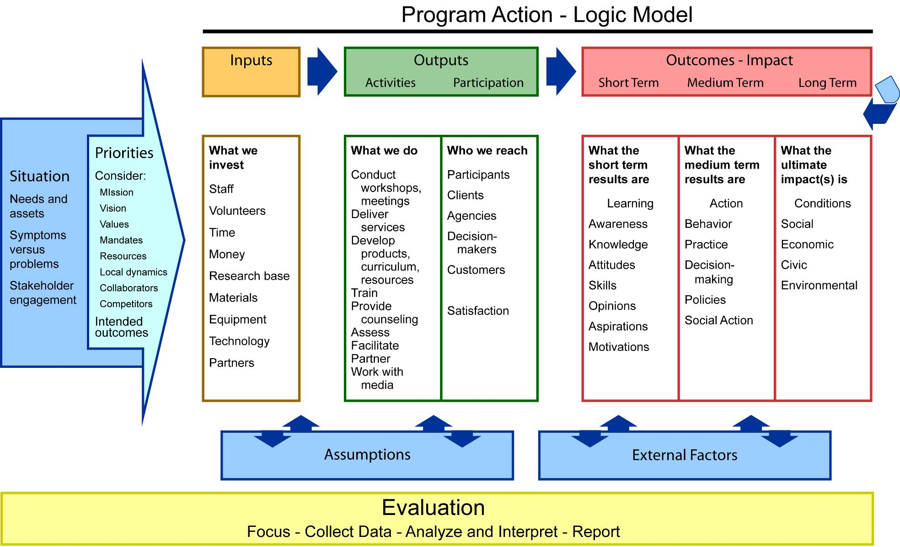
Fully detailed logic model
Notes:
Here we have a full depiction of program development. We see that everything starts with a clear articulation of the originating situation from which priorities are set. This sets into motion the programmatic response – as displayed in the logic model of what is expected to occur…the connections and relationships between inputs-outputs- and outcomes.
Often not included in the graphical LM display but important to articulate are
Assumptions
External factors, for example, do financial institutions exist; are they accessible
(barriers and facilitators)
Evaluation runs over the course of the program and is part of the program design.
Looks linear but is not…

Slide 8
Logic model examples
Conceptual/program design and implementation
Specific metrics/impact

Slide 11
Simple Logic Model
Outputs (What you do and who you reach) | Output Measurement (How you know what you did) | Outcomes (Changes in what you intend to affect) | Outcome Measurement (How you know what you changed)
Assumptions
Ultimate Impact
Inputs

Slide 12
Performance Recipe
Specific
Measurable
Agreed upon
Realistic
Time limited
Evaluated
Reevaluated

Slide 13
Performance Recipe (+)
Specific and Compelling
Measurable and Moveable
Agreed upon and Available
Realistic (Plausible and Practical)
Time limited
Evaluated
Reevaluated

Slide 14
Working through an example
What do we want to know?
Why do we need to know?
Whom will we tell?
How will we know it?
What will we measure?
Where will we get the data?
Example can focus on design, implementation, outcomes, or impact
All must focus on a strategic goal– beginning with the end in mind

Slide 15
“The secret of getting ahead is getting started. The secret of getting started is breaking your complex, overwhelming tasks into small, manageable tasks, and then starting on the first one.”
--Mark Twain

Slide 16
Data sources
Required program monitoring data
Other program data your agency collects
Monitoring, Improvement, Problem-solving
New data collection
Existing local, state, and national data, measures
AGID
Healthy People 2010, 2020
State and county demographics
POMP

Slide 17
Resources
AoA Care Transitions Toolkit
http://www.aoa.gov/AoARoot/AoA_Programs/HCLTC/ADRC_CareTransitions/Toolkit/index.aspx
University of Wisconsin Logic Model http://www.uwex.edu/ces/pdande/evaluation/evallogicmodel.html
Community Care Transitions Toolkit
http://www.cfmc.org/integratingcare/files/Care_Transitions_toolkit_090611_Final.pdf
Basics of Outcome Measurement
http://www.cfmc.org/caretransitions/toolkit_measure.html
Performance Measurement Challenges and Strategies http://www.whitehouse.gov/sites/default/files/omb/part/challenges_strategies.html

Slide 18
More Resources
AHRQ Care Coordination Measures Atlas http://www.ahrq.gov/qual/careatlas/
Data for Benchmarks: AoA AGID
www.agidnet.org
Healthy People 2010, 2020
County level data (health)
State census numbers (age, gender, living situation, income, race)
Other state data: www.kaiseredu.org
Compendium of state data on health services, $$, providers, health of residents,

Slide 19
More Resources
REAIM—Evaluation Frameworks www.reaim.org
Transforming Data Into Practical Information
Applebaum, Kunkel & Wilson, The Gerontologist, 47 (1), 2007.
Outcome Indicators Project (Urban Institute)
http://www.urban.org/center/cnp/projects/outcomeindicators.cfm
Brown-Williams, H. et al. (2006). From Hospital to Home: Improving Transitional Care for Older Adults. Health Research for Action: University of California, Berkley, California.

Slide 20
Data for Benchmarks:
www.data.aoa.gov
Healthy People 2010, 2020
County level data (health)
www.agidnet.org
Program Evaluation/Measurement
Checklist for Evaluation Reports (RWJ)
http://www.rwjf.org/files/research/50349.quality.checklist.final.pdf
Basic Guide to Program Evaluation
http://www.managementhelp.org/evaluatn/fnl_eval.htm

Slide 21
Other state data: www.kaiseredu.org
Compendium of state data on health services, $$, providers, health of residents
NTOCC Transitions of Care Measures, Paper by the NTOCC Measures Work Group, 2008. http://www.ntocc.org/Portals/0/TransitionsOfCare_Measures.pdf

